Slide 1

Artificial Intelligence Foundation
KKB 人工智能学院

Slide 2
Numerical & Categorical
One-hot
Word Embedding
WordVec
WordVec in Machine Learning

Slide 3
All are numbers

Slide 4
Categorical & Numerical

Slide 5
Categorical
Could not be compared
Could not be sorted
The Number just is a
representation
Numerical
Could be compared
Could be sorted
The number with attribute

Slide 6
Why it counts?

Slide 7
One-Hot and Embedding

Slide 8
K-means
The approach kmeans follows to solve the problem is called Expectation-Maximization.
Online Coding

Slide 9
Word2Vec与文本表征
Review：
Neural Networks
Backpropagation
Graph Computing
Gradient Descent
Word Embedding与词向量
词向量的原理
哈弗曼树与Negative Samples
Glove, CoVe, EMLO等高级词向量方式
句子向量
句子向量的使用背景
句子向量的构建
利用词向量找到隐藏词汇、新词汇
项目1简介：非监督式文本摘要模型

Slide 10
文字意义的重要性

Slide 12
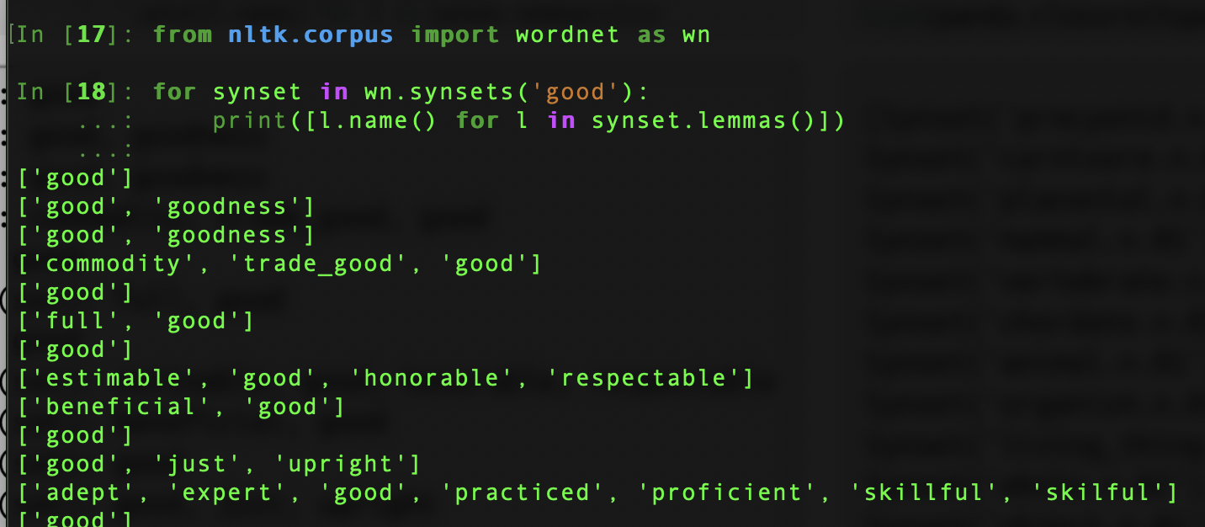
Representation – Using Meaning
我们经常使用同义词或者反义词来定义一个单词的意思

Slide 13
1. Commodity, upright 只在部分情况下正确
2. 需要大量的人力成本
3. 并不能使用数学的方式计算单词之间的相似性

Slide 14
Representation – Using Numerical
Why do we need to represent words and text?
The only could be computing is number for computers.
How to represent words?
ASCII: a, b, c : 97, 98, ‘abc’: 979899
Unicode:
etc: UTF-8

Slide 15

Why do not represent words as numbers?
‘你今天真好看’: \u12412, \u32121, \u5542,\u189301 => [12412, 32121, 5542, 189301]
Is words numeric or categorical?
How can we represent it as one-hot?

Slide 16
If we treat we words as mere categorical
[0, 0, 0, 1]
[0, 1, 0, 0]
[1, 0, 0, 0]
[0, 0, 1, 0]
Cannot keep similarity: (v1 + v2) · v3 == v1 · v3

Slide 17
Question
The problem of representing words as one-hot.
[ ] A. Cannot represent the relation of ‘similar' words and some ‘not similar words’;
[ ] B. The are space consuming;
[ ] C. It’s difficult to get the values;
[ ] D. If we add new words, we need to re-calculate all the words;

Slide 18
Some more dense vectors
1. If we do PCA of this of this one-hot matrix;
What is PCA
How do we get PCA: https://www.wikiwand.com/en/Principal_component_analysis
2. If we do SVD of this one-hot matrix;
What is SVD
How do we get SVD: https://www.wikiwand.com/en/Singular-value_decomposition

Slide 19
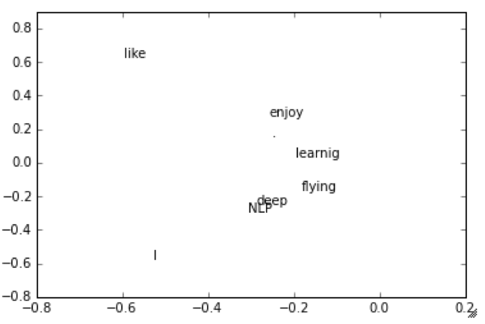
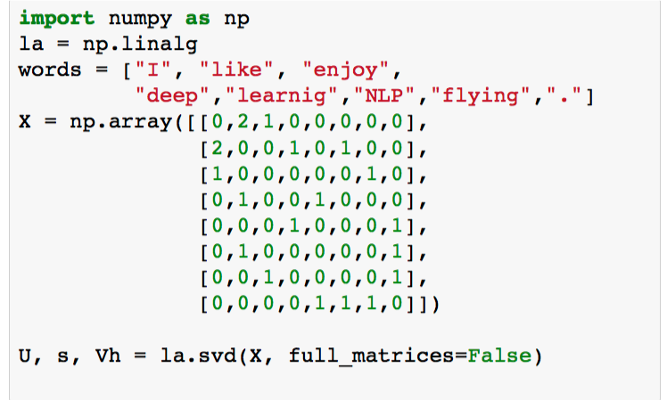
SVD

Slide 20
Question
Problems SVD:
[ ] A. When adding new words, need recalculate all the words;
[ ] B. It’s computing consuming.
[ ] C. This algorithm it’s hard to implement.
[ ] D. Cannot Solving Polyseme(多义词)

Slide 21




What features do our vectors need ?
1. Space Economical
2. Adaptively Update
3. Semantic Similarity
But how?

Slide 22
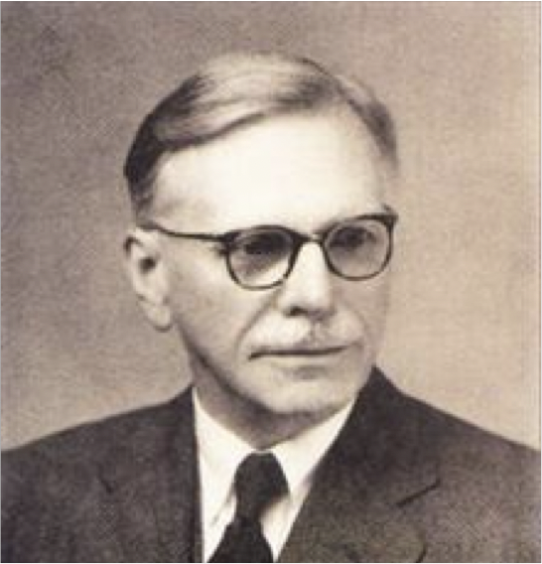
使用单词的上下文进行表征
“You shall know a word by the company it keeps” – J.R.Firth 1957
“每天早上我都要去门口那家早餐店吃___”
“昨天早上我是在家做的___，味道还不错”
Assuming a density vector <v1, v2, .. vN>
If occurrence position of some words always is same of the position of this vector;
We get the similar vector;

Slide 23
单词的意思和上下文
这里是汉武帝长公主的坟墓
今年的麦子长得挺好的
绳子不够长，再去买一根吧
Meaning(长) = function(上下文)
Meaning(长-01) = function(这里，是，汉武帝，公主，的，坟墓)
Meaning(长-02) = function(今年, 麦子，得， 挺好， 的)
Meaning(长-03) = function(绳子，不够，再去买一根吧)

Slide 24
Meaning(长) = function(上下文)
Meaning(长-01) = function(这里，是，汉武帝，公主，的，坟墓)
Meaning(长-02) = function(今年, 麦子，得， 挺好， 的)
Meaning(长-03) = function(绳子，不够，再去买一根吧)
=>
如果某两个单词的上下文相似，那么function的结果也是相似的，即，单词的意思相似

Slide 25

Word2Vec 词向量
Mikolov et.al 2013, Google
我们计算 P($w_{t+j}|w_{c}$)
这个
是
对
未来
计划
的
一
部分

Slide 26
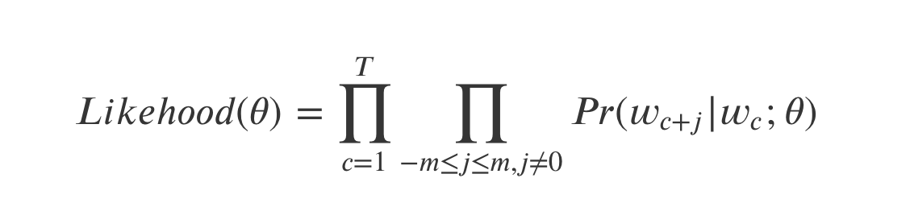
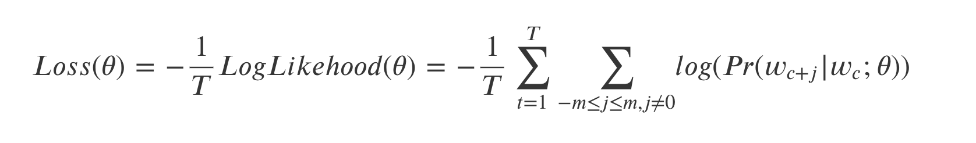
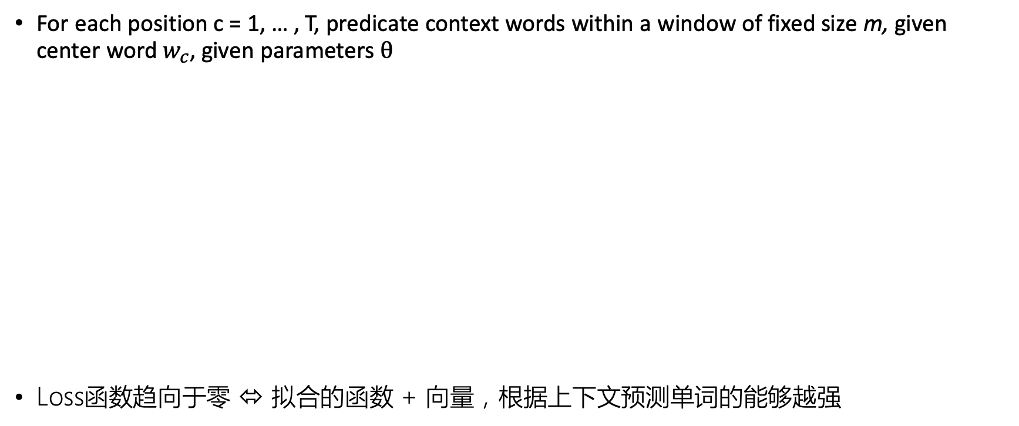
Word2Vec Neural Network Model: Object Function
For each position c = 1, … , T, predicate context words within a window of fixed size m, given center word $w_{c}$, given parameters $θ$
Loss函数趋向于零 ⬄ 拟合的函数 + 向量，根据上下文预测单词的能够越强

Slide 27
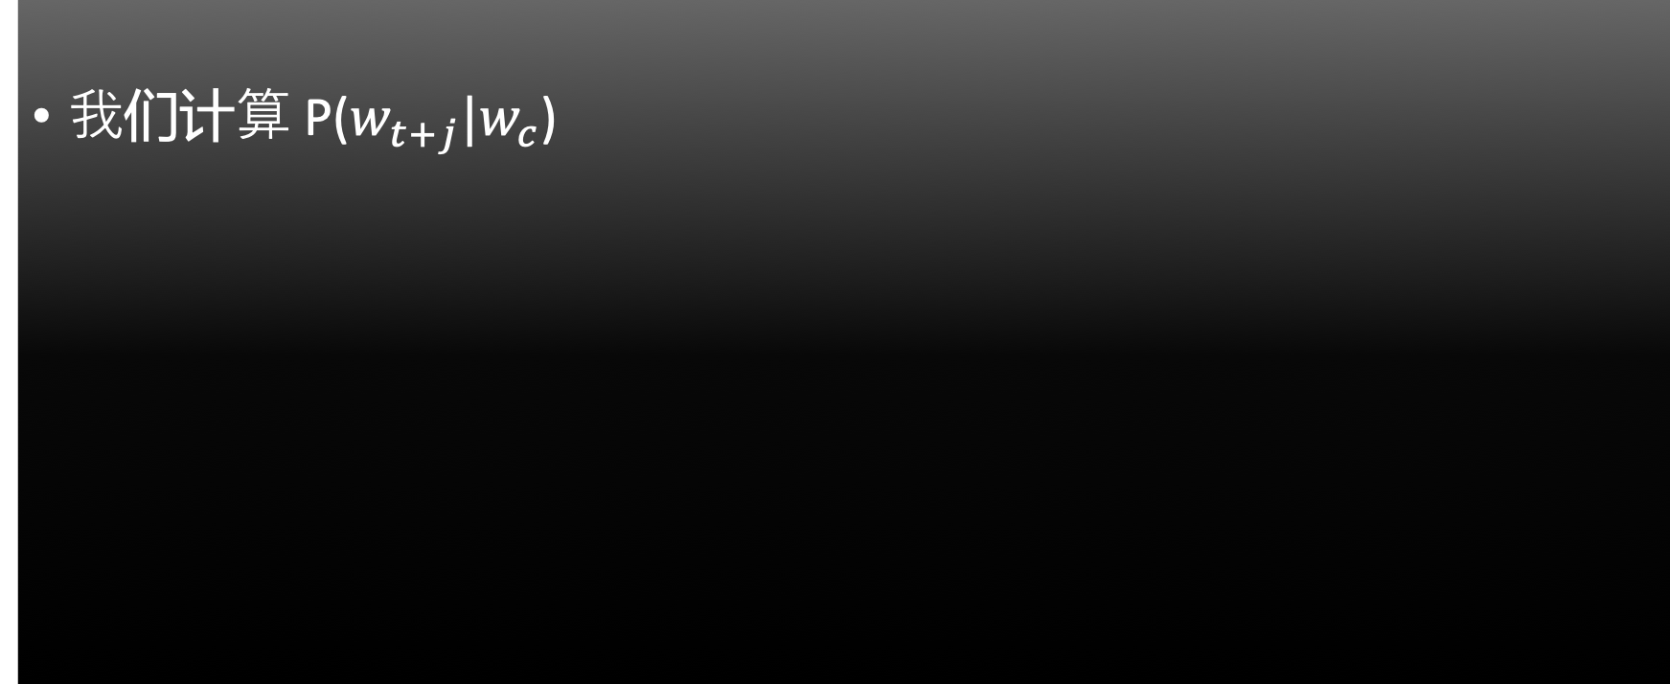
我们计算 P($w_{t+j}|w_{c}$)
Pr(一|计划)
Pr(对|计划)
Pr(未来|计划)
这个
是
对
未来
计划
的
一
部分
Pr(部分|计划)

Slide 28
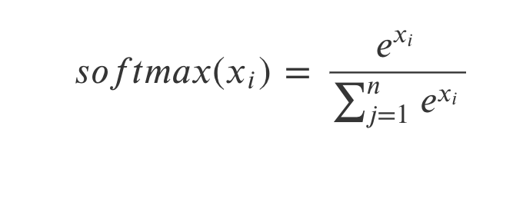
Softmax 函数
Softmax函数可以把任意给定的向量X变成概率分布
Max: 把X中最大的x_i 值变得更大
Soft: 依然对较小的值会给到权重

Slide 29
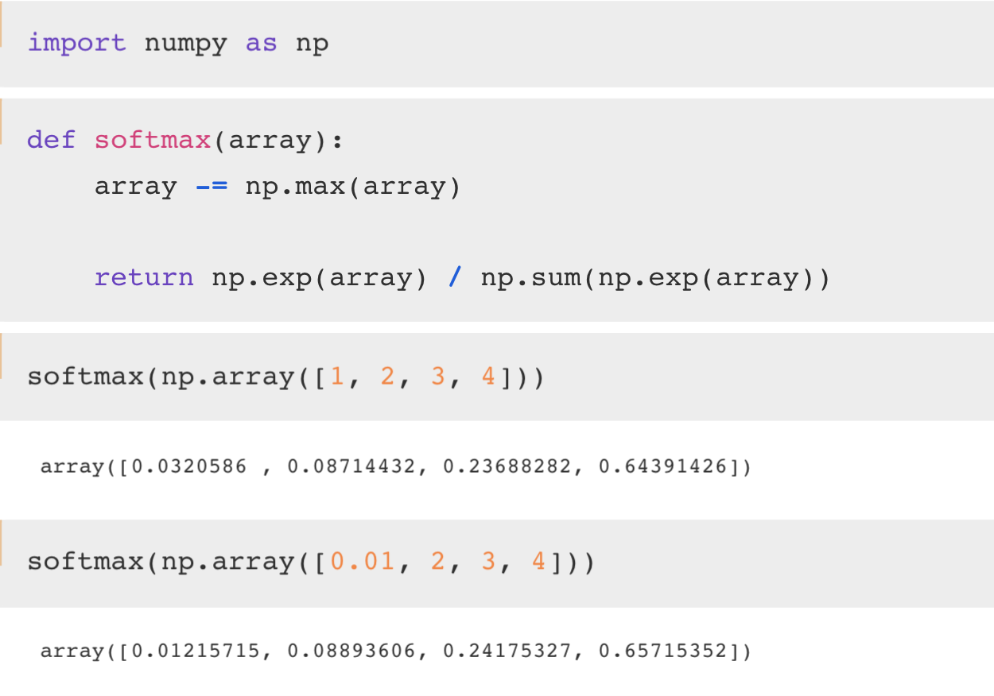
More detail
Array -= ?

Slide 30
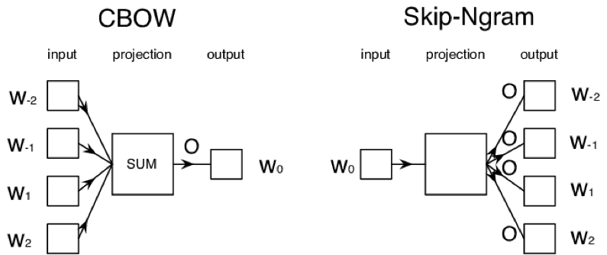
Word2Vec two models
Two model variants:
1. Skip-Gram (SG): Predict context (”outside”) words (position independent) given center word
2. Continuous Bag of Words (CBOW):Predict center word from (bag of) context words

Slide 31
Vi^T * Vc
0.01
0.21
0.31
..
..
..
..
..
..
0.03
v_i
v_c_i
softmax

Slide 32
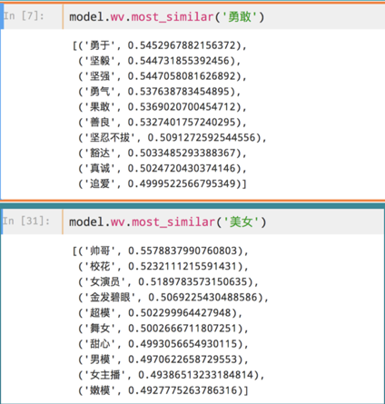

Slide 33
Next: Online Practice

